Slide 1
Set Operations
Computer Science, Purdue University
Copyright McGraw Hill, Rosen, Discrete Mathematics and its Applications

Slide 2

Set Operations
Set Union
Definition: Let A and B be sets. The union of the sets A and B, denoted by A ∪ B, is the set:
Example: What is {1,2,3} ∪ {3, 4, 5}?
Solution: {1,2,3,4,5}
Venn Diagram for A ∪ B
U
A
B
Computer Science, Purdue University

Slide 3

Set Operations
Set Intersection
Definition: The intersection of sets A and B, denoted by A ∩ B, is
Note if the intersection is empty, then A and B are said to be disjoint.
Example: What is {1,2,3} ∩ {3,4,5} ?
Solution: {3}
Example: What is {1,2,3} ∩ {4,5,6} ?
Solution: ∅
Venn Diagram for A ∩B
U
A
B
Computer Science, Purdue University

Slide 4
Set Operations
Set Complement
Definition: If A is a set, then the complement of the A (with respect to U), denoted by Ā is the set U - A
Ā = {x ∈ U | x ∉ A}
(The complement of A is sometimes denoted by A^{c} .)
Example: If U is the positive integers less
than 100, what is the complement of
{x | x > 70}
Solution: {x | x ≤ 70}
Venn Diagram for Complement
U
A
Computer Science, Purdue University

Slide 5
Set Operations
Set Difference
Definition: Let A and B be sets. The difference of A and B, denoted by A – B, is the set containing the elements of A that are not in B. The difference of A and B is also called the complement of B with respect to A.
A – B = {x | x ∈ A ∧ x ∉ B} = A ∩‾B
U
Venn Diagram for A − B
A
B
Computer Science, Purdue University

Slide 6
Set Operations
Cardinality of union of Sets
Inclusion-Exclusion
|A ∪ B| = |A| + | B| − |A ∩ B|
Example: Let A be the math majors in your class and B be the CS majors. To count the number of students who are either math majors or CS majors, add the number of math majors and the number of CS majors, and subtract the number of joint CS/math majors.
U
A
B
Venn Diagram for A, B, A ∩ B, A ∪ B
Computer Science, Purdue University

Slide 7
Set Operations
Some Examples
Example: U = {0,1,2,3,4,5,6,7,8,9,10} A = {1,2,3,4,5}, B ={4,5,6,7,8}
A ∪ B
Solution: {1,2,3,4,5,6,7,8}
A ∩ B
Solution: {4,5}
Ā
Solution: {0,6,7,8,9,10}
Solution: {0,1,2,3,9,10}
A – B
Solution: {1,2,3}
B – A
Solution: {6,7,8}
Computer Science, Purdue University

Slide 8


Set Operations
Symmetric Difference
Definition: The symmetric difference of A and B, denoted by is the set
Example:
U = {0,1,2,3,4,5,6,7,8,9,10}
A = {1,2,3,4,5} B ={4,5,6,7,8}
What is ?
Solution: {1,2,3,6,7,8}
U
A
B
Venn Diagram
Computer Science, Purdue University

Slide 9






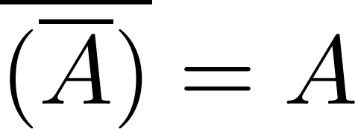
Set Operations
Set Identities
Identity laws
Domination laws
Idempotent laws
Complementation law
Computer Science, Purdue University

Slide 10


Set Operations
Set Identities
Commutative laws
Associative laws
Distributive laws
Computer Science, Purdue University

Slide 11





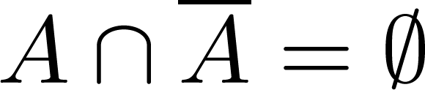
Set Operations
Set Identities
De Morgan’s laws
Absorption laws
Complement laws
Computer Science, Purdue University

Slide 12
Set Operations
Proving Set Identities
Different ways to prove set identities:
Prove that each set (side of the identity) is a subset of the other.
Use set builder notation and propositional logic.
Membership Tables: Verify that elements in the same combination of sets always either belong or do not belong to the same side of the identity. Use 1 to indicate it is in the set and a 0 to indicate that it is not.
Computer Science, Purdue University

Slide 13


Set Operations
Proving Set Identities
Example: Prove that
Solution: We prove this identity by showing that:
1) and
2)
Computer Science, Purdue University

Slide 14
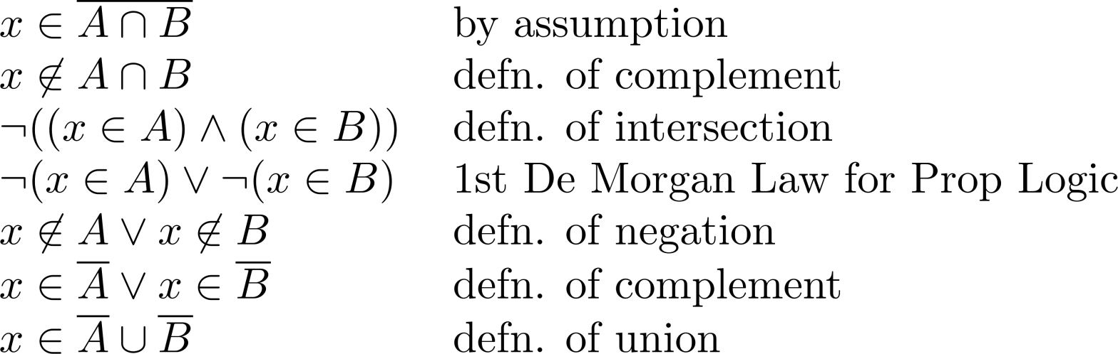
Set Operations
Proof of DeMorgan’s Laws on Sets
These steps show that:
Computer Science, Purdue University

Slide 15
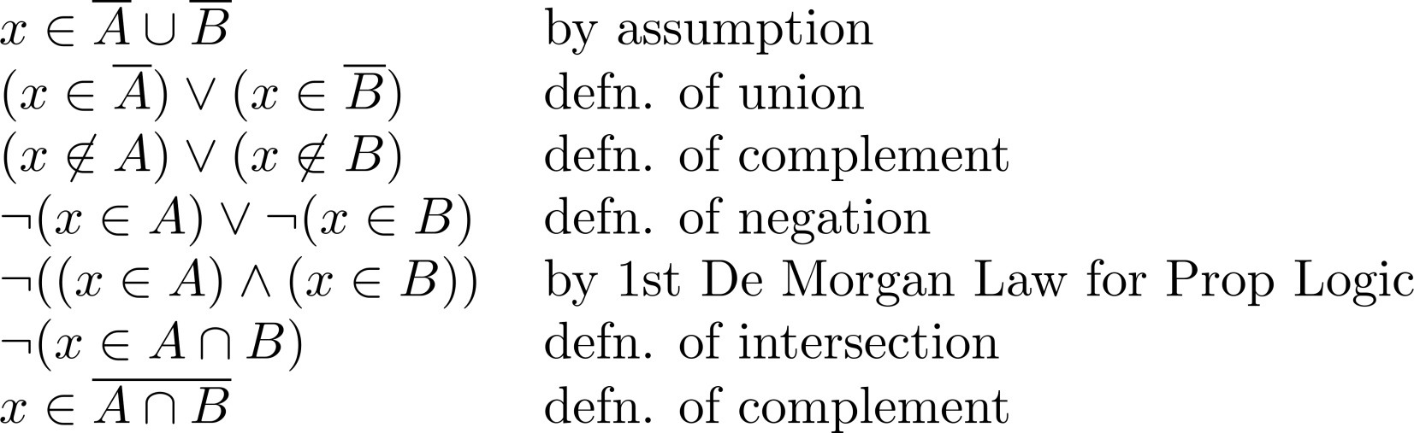
Set Operations
Proof of DeMorgan’s Laws on Sets
These steps show that:
Computer Science, Purdue University

Slide 16
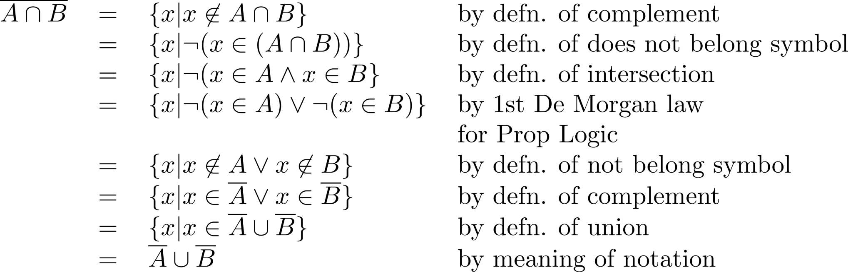
Set Operations
Set Builder Notation Proof of DeMorgan’s Law
Computer Science, Purdue University

Slide 17





Set Operations
Proof Using Membership Tables
Example:
Construct a membership table to show that the distributive law holds.
Solution:
A | B | C
1 | 1 | 1 | 1 | 1 | 1 | 1 | 1
1 | 1 | 0 | 0 | 1 | 1 | 1 | 1
1 | 0 | 1 | 0 | 1 | 1 | 1 | 1
1 | 0 | 0 | 0 | 1 | 1 | 1 | 1
0 | 1 | 1 | 1 | 1 | 1 | 1 | 1
0 | 1 | 0 | 0 | 0 | 1 | 0 | 0
0 | 0 | 1 | 0 | 0 | 0 | 1 | 0
0 | 0 | 0 | 0 | 0 | 0 | 0 | 0
Computer Science, Purdue University

Slide 18
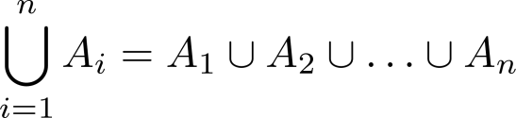
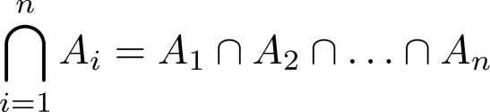
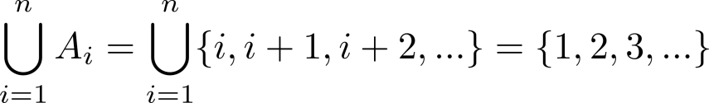
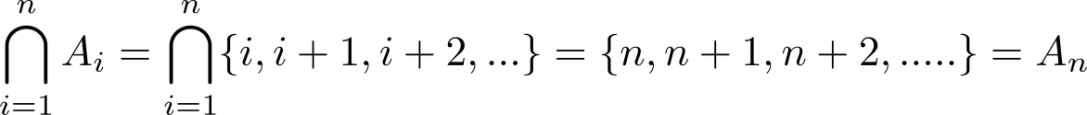
Set Operations
Generalized Unions
Let A₁, A₂ ,…, A_{n} be an indexed collection of sets.
We define:
These are well defined, since union and intersection are associative.
Example: For i = 1,2,…, let A_{i} = {i, i + 1, i + 2, ….}. Then,
Computer Science, Purdue University

Slide 19
Thank You

